Slide 1
UNIFIED PROCESS

Slide 2
UNIFIED PROCESS
A popular iterative modern process model (framework) derived from the work on the UML and associated process.
The leading object-oriented methodology for the development of large-scale software
Maps out when and how to use the various UML techniques

Slide 3
CHARACTERISTICS OF UNIFIED PROCESS
It is use-case driven
It is architecture-centric
It is risk focused
It is iterative and incremental
It uses UML for all blueprints.

Slide 4
PHASES OF UNIFIED PROCESS
This process divides the development process into four phases:
Inception
Elaboration
Conception
Transition

Slide 5
INCEPTION
AIM:
Determine whether the proposed software product is economically feasible.
There are several steps for this phase:
1. Gain an understanding of the domain
2. Build the business model
• Understand precisely how the client organization operates
in the domain
3. Delimit the scope of the proposed project
• Focus on the subset of the business model that is
covered by the proposed software product
4. Begin to make the initial business case

Slide 6
INCEPTION PHASE: DOCUMENTATION
The deliverables of the inception phase include:
– The initial version of the domain model
– The initial version of the business model
– The initial version of the requirements artifacts
– A preliminary version of the analysis artifacts
– A preliminary version of the architecture
– The initial list of risks
– The initial ordering of the use cases
– The plan for the elaboration phase
– The initial version of the business case

Slide 7
ELABORATION PHASE
AIM:
– Refine the initial requirements
– Refine the architecture
– Monitor the risks and refine their priorities
– Refine the business case
– Produce the project management plan
• The major activities of the elaboration phase are refinements or elaborations of the previous phase

Slide 8
ELABORATION PHASE: DOCUMENTATION
The deliverables of the elaboration phase include:
– The completed domain model
– The completed business model
– The completed requirements artifacts
– The completed analysis artifacts
– An updated version of the architecture
– An updated list of risks
– The project management plan for the rest of the project
– The completed business case

Slide 9
CONSTRUCTION PHASE
AIM:
To produce the first operational-quality version of the software product
– This is sometimes called the beta release
The emphasis in this phase is on
– Implementation and
– Testing
• Unit testing of modules
• Integration testing of subsystems
• Product testing of the overall system

Slide 10
CONSTRUCTION PHASE:
DOCUMENTATION
The deliverables of the construction phase include:
– The initial user manual and other manuals, as appropriate
– All the artifacts (beta release versions)
– The completed architecture
– The updated risk list
– The project management plan (for the remainder of the project)

Slide 11
TRANSITION PHASE
AIM:
To ensure that the client’s requirements have indeed been met
– Faults in the software product are corrected
– All the manuals are completed
– Attempts are made to discover any previously unidentified risks
• This phase is driven by feedback from the sites at which the beta release has been installed

Slide 12
TRANSITION PHASE : DOCUMENTATION
The deliverables of the transition phase include:
– All the artifacts (final versions)
– The completed manuals

Slide 13
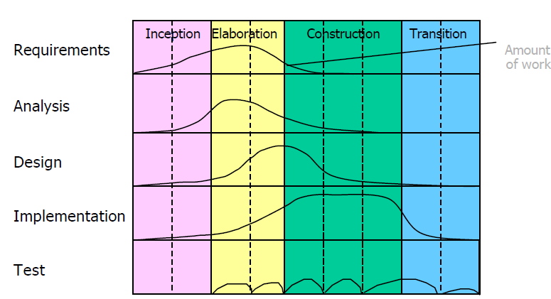
PHASES AND WORKFLOWS

